Slide 1

Form Validation
Praveena sagi
RA – Idrbt hyderabad

Slide 2
Overview
Form Creation
Field Validation
Application demo

Slide 3
Form Creation
layout Design: Create an XML layout file (activity_main.xml or any custom name) to design your form UI using various views like EditText, Button, etc.
Arrange views using LinearLayout, RelativeLayout, ConstraintLayout, etc., as per your design.
Add Views: Add EditText for input fields where users can enter data.
Add a Button for form submission.

Slide 4
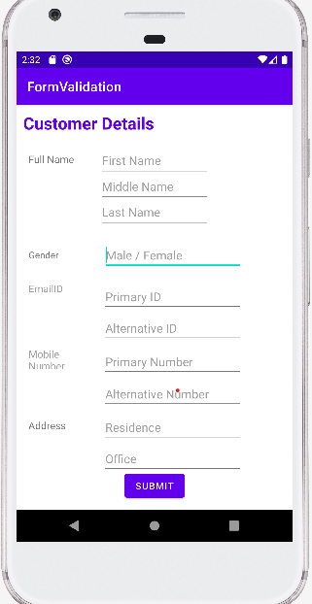
This is the UI of the application, Where we have 10 EditFields,1 button,5 TextViews

Slide 5
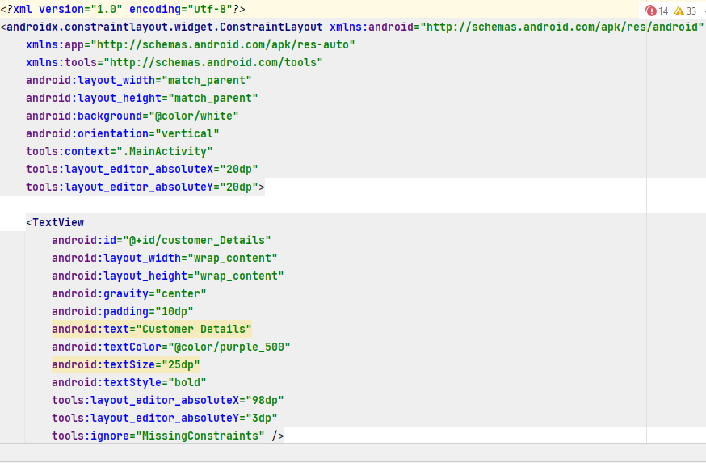
Constraint Layout is a ViewGroup (i.e. a view that holds other views) which allows you to create large and complex layouts with a flat view hierarchy, and also allows you to position and size widgets in a very flexible way.

Slide 6
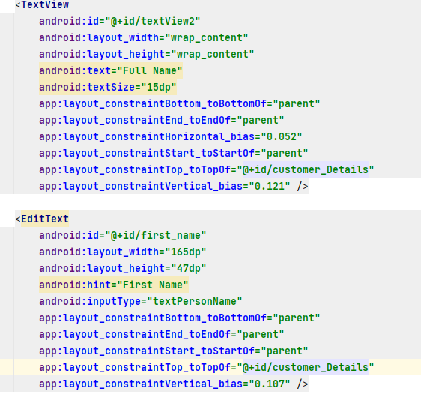
Here we are creating TextView for FullName
Here we are creating EditText for FirstName

Slide 7
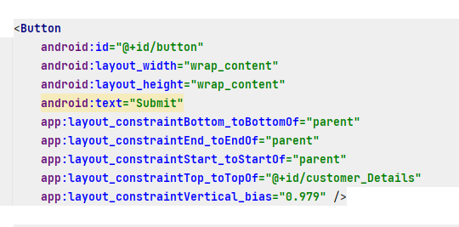
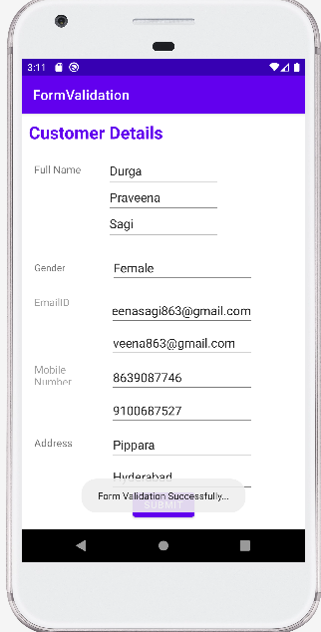
Here we are creating Submit Button

Slide 8
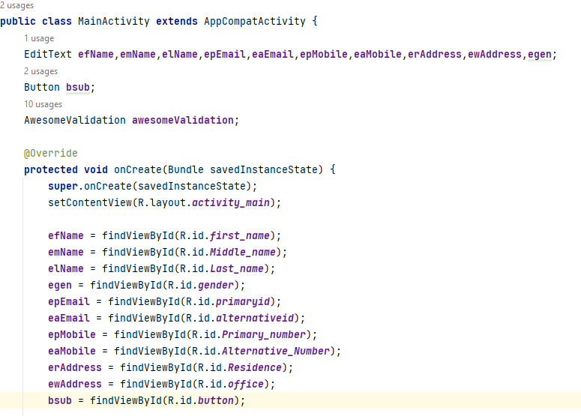
First have to call all Buttons and TextView through ID in MainActivity.java file and have to declare onClickListener method

Slide 9
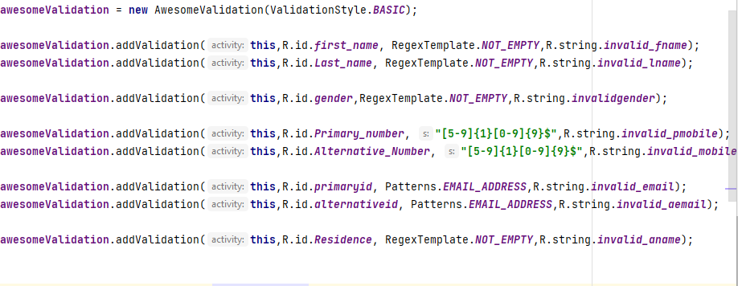
Awesome Validation is a lightweight Android library that simplifies the process of validating user input fields in your Android applications. It provides a simple and easy-to-use API for defining validation rules and applying them to your EditText views.
RegexTemplate is a library that helps you to use regular expressions in Android Studio. It provides a set of classes and methods that make it easier to compile and match regular expressions, and to extract information from matched text.

Slide 10
.
Here are some of the key benefits of using Awesome Validation for field validation:
Reduced boilerplate code: Awesome Validation eliminates the need to write repetitive validation code for each input field.
Declarative syntax: Awesome Validation uses a declarative syntax for defining validation rules, making it easier to read and maintain your code.
Configurable error messages: Awesome Validation allows you to customize the error messages that are displayed to the user when an input field fails validation.
Support for multiple validation rules: Awesome Validation supports multiple validation rules per input field, allowing you to perform complex validation checks.

Slide 11

So we are going to use AwesomeValidation. So first come inside app level build.gradle file and add the following line inside dependencies block
Adding AwesomeValidation Library.
Now after adding the above line sync your project.

Slide 12
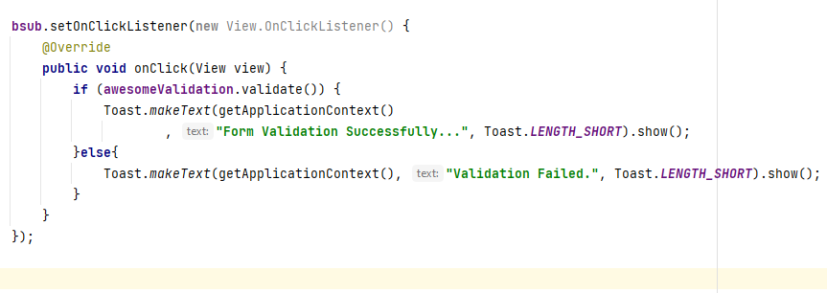
This code sets a click listener on the button with the ID bsub.
When the button is clicked, it checks if the form is valid.
If the form is valid, it displays a success message.
If the form is not valid,it displays an error message.

Slide 14
THANK YOU

